Slide 1


DATA VISUALIZATION

Slide 2

Module Agenda
Introduction to data visualization
Popular data visualization libraries in Python
Data Visualization Types:
Relationships
Comparisons
Distribution
Composition
Practical Example 1: GenAI for individual stock data visualization
Practical Example 2: GenAI for multiple stocks analysis and visualization
Practical Example 3: GenAI for cancer data visualization
Practice Opportunity
© All rights reserved for Dr. Ryan Ahmed @Stemplicity Inc.

Slide 3
INTRODUCTION TO DATA VISUALIZATION

Slide 4
Financial Planning and Analysis
Data Wrangling & Analysis: Automate reconciliation and analysis of financial data.
Competitor Analysis: Analyze competitors' financials and strategic positioning.
Anomaly Detection: Identify errors in financial transactions with AI.
Sales Forecasting: Predict financial performance using historical data and market trends.
Variance Analysis: Analyze actuals vs. budgets to pinpoint variances and corrective actions.
Scenario Planning: Model scenarios to evaluate business decisions' financial impacts.
Financial Narratives: Generate AI-driven insights for clear stakeholder communication.
Cost Optimization: Identify inefficiencies and recommend cost-saving measures.
Data Visualization: Visualize financial data for strategic decision making
Financial Prediction Using ML Regression: Predict financial metrics such as revenues& expenses.
Financial Planning and Analysis (FP&A) is a critical business function that focuses on providing financial insights to support decision-making and drive a company’s strategic objectives.
It involves analyzing financial data, forecasting future financial performance, budgeting, and offering recommendations to enhance financial health and operational efficiency.
© All rights reserved for Dr. Ryan Ahmed @Stemplicity Inc.

Slide 5



Popular Data Visualization Libraries
Python offers many libraries for data visualization such as Matplotlib, Seaborn, and Plotly.
Grandfather of data visualization libraries.
It creates static & interactive visualizations.
Link: https://matplotlib.org/
Based on Matplotlib & offers enhanced features.
Generates aesthetically appealing statistical plots.
Link: https://seaborn.pydata.org/
Plotly creates interactive charts using few code lines.
Offers 40+ chart types (statistical, financial & scientific).
Link: https://plotly.com/python/
© All rights reserved for Dr. Ryan Ahmed @Stemplicity Inc.

Slide 6
DATA VISUALIZATION TYPES

Slide 7
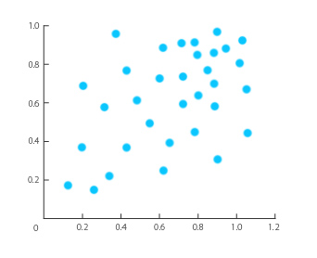
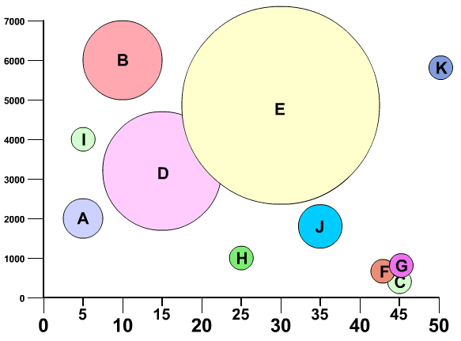
Relationships
SCATTERPLOT
BUBBLE CHART
“Scatterplot demonstrates the relationship between two variables (X, Y)”
“Bubble chart demonstrates the relationship between three variables (X, Y, Bubble Size)
© All rights reserved for Dr. Ryan Ahmed @Stemplicity Inc.
Photo Credit: https://commons.wikimedia.org/wiki/File:Example_of_Scatter_Plot.jpg
Photo Credit: https://commons.wikimedia.org/wiki/File:Bubble_chart.jpg

Slide 8
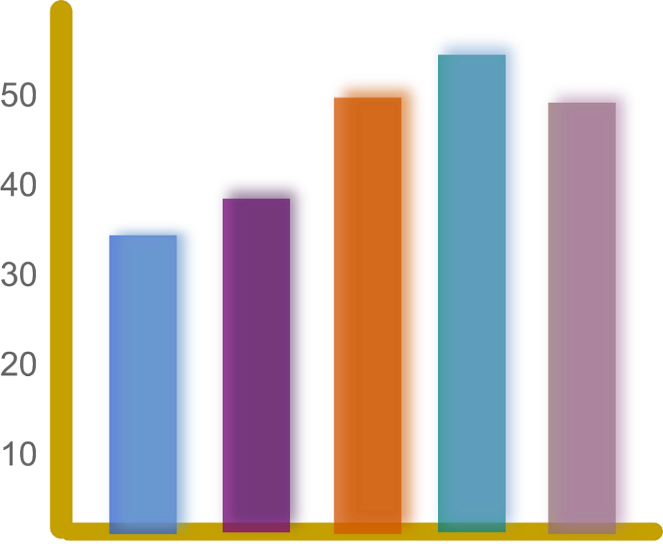
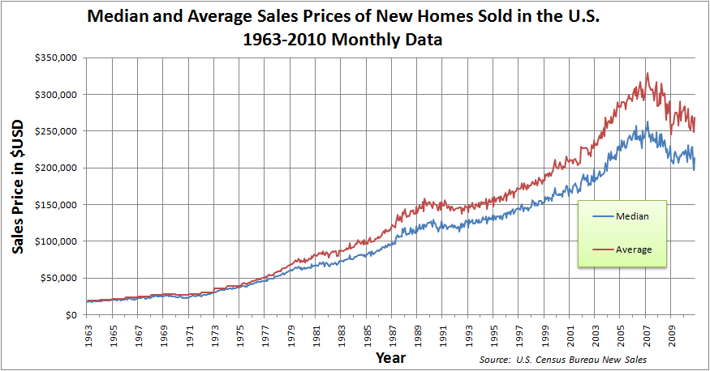
Comparisons
BAR CHART
LINE CHART
“Comparing salaries”
“Comparing median and average House prices over the years”
© All rights reserved for Dr. Ryan Ahmed @Stemplicity Inc.
Employee #1
Employee #2
Employee #3
Employee #4
Employee #5

Slide 9
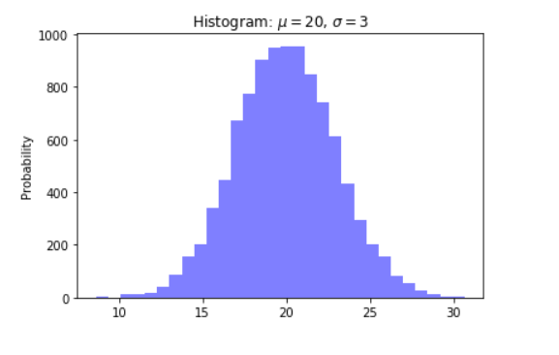
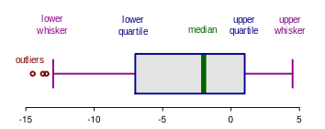
Distributions
HISTOGRAMS
BOX PLOT
© All rights reserved for Dr. Ryan Ahmed @Stemplicity Inc.
Photo Credit: https://commons.wikimedia.org/wiki/File:Elements_of_a_boxplot_en.svg

Slide 10
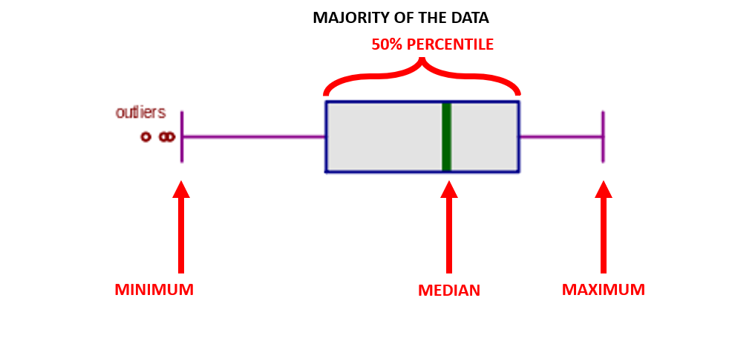
Box Plot
A boxplot is a graphical representation of the distribution of a dataset. It summarizes key aspects of the data, such as its central tendency, spread, and presence of outliers.
Recall: The median is the middle number in a sorted list of numbers.
It is the point above and below which 50% of the data falls.
© All rights reserved for Dr. Ryan Ahmed @Stemplicity Inc.
Photo Credit: https://commons.wikimedia.org/wiki/File:Elements_of_a_boxplot_en.svg

Slide 11
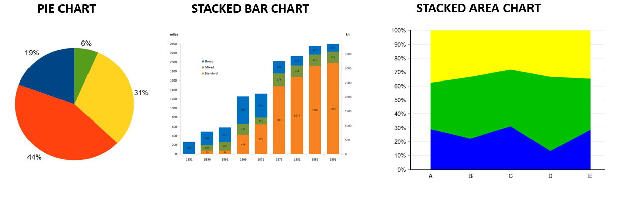
Composition
© All rights reserved for Dr. Ryan Ahmed @Stemplicity Inc.
Photo Credit: https://commons.wikimedia.org/wiki/File:Broad_and_standard_mileage_operated_by_GWR.png
Photo Credit: https://commons.wikimedia.org/wiki/File:Charts_SVG_Example_12_-_Stacked_100%25_Area_Chart.svg
Photo Credit: https://commons.wikimedia.org/wiki/File:Pie-chart.jpg

Slide 12
KEY TERMINOLOGIES IN STOCKS ANALYSIS

Slide 13
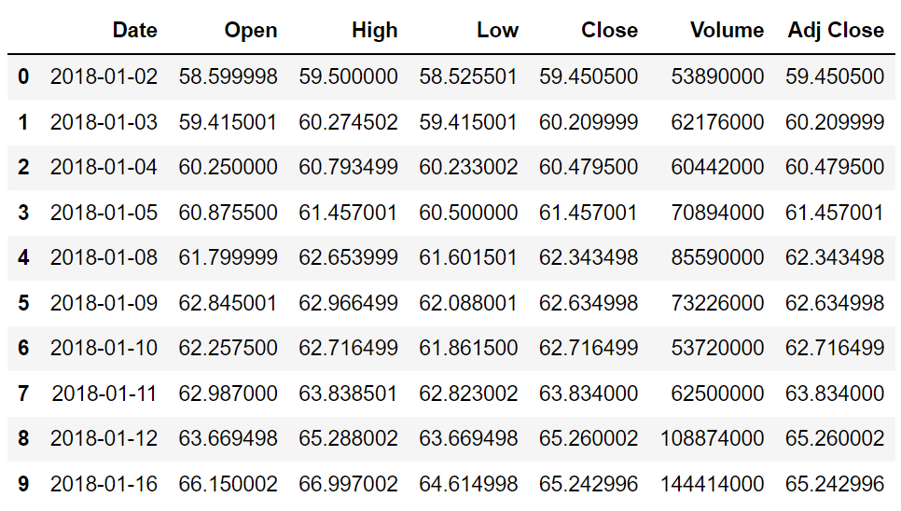
Key Terminologies
Open: opening price at which a security first trades when the stock market opens.
The New York Stock Exchange (NYSE) opens at 9:30 AM EST.
Shanghai Stock Exchange (SSE) opens at 9:30 AM China Standard Time.
High: highest price at which a given stock is traded during a regular trading session.
Low: lowest price at which a given stock is traded during a regular trading session.
Close: represents the last price a given stock trades during a regular trading session.
Volume: number of shares traded between the market open and close.
Adj Close: adjusted stock close price after considering stock splits and dividends.
© All rights reserved for Dr. Ryan Ahmed @Stemplicity Inc.

Slide 14
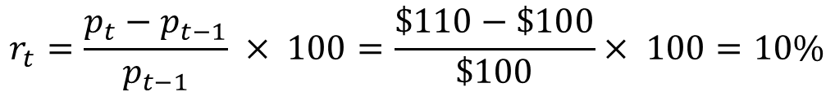
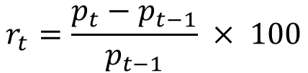
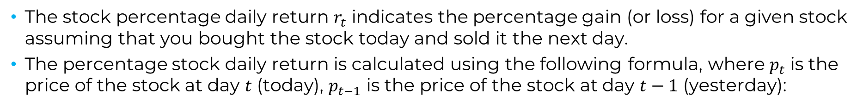
Percentage Daily Returns Calculation
The stock percentage daily return $r_{t}$ indicates the percentage gain (or loss) for a given stock assuming that you bought the stock today and sold it the next day.
The percentage stock daily return is calculated using the following formula, where $p_{t}$ is the price of the stock at day $t$ (today), $p_{t−1}$ is the price of the stock at day $t−1$ (yesterday):
$$r_{t}=\frac{p_{t}−p_{t−1}}{p_{t−1}} × 100$$
Example: assume that you bought XYZ Inc. stock today at $100 per share. The price of the stock increased to $110 the next day. The percentage daily return is calculated as follows:
© All rights reserved for Dr. Ryan Ahmed @Stemplicity Inc.
$$r_{t}=\frac{p_{t}−p_{t−1}}{p_{t−1}} × 100=\frac{\$110−\$100}{\$100}× 100=10\%$$

Slide 15
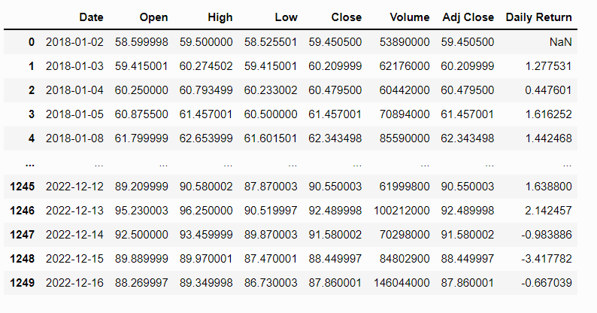
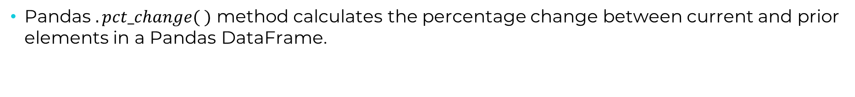
Percentage Daily Returns Calculation
Pandas $.pct_change( )$ method calculates the percentage change between current and prior elements in a Pandas DataFrame.
stock_df ['Daily Return'] = stock_df['Adj Close'].pct_change(1) * 100
New Column that Stores
the Percentage Daily Return
Input Column
Pandas Method
Number of Periods
© All rights reserved for Dr. Ryan Ahmed @Stemplicity Inc.
New % Daily Return Column

Slide 16
PRACTICAL EXAMPLES 1-3: GENAI FOR DATA VISUALIZATION

Slide 17

Practical Examples 1-3
🔗 Click here to explore ChatGPT ChatGPT Signup
💡 Click here for AI Prompts Explore Prompts
© All rights reserved for Dr. Ryan Ahmed @Stemplicity Inc.

Slide 18
PRACTICE OPPORTUNITY

Slide 19

Practice Opportunity
Background: Walmart operates a network of retail home improvement and hardware stores across multiple locations. With large volumes of transactional and operational data, understanding performance at individual stores and identifying improvement opportunities is critical.
Available Dataset:
Store ID: Unique identifier for each store.
City: Location of the store.
Week: Week of observation.
Weekly Revenue: Revenue generated in USD.
Weekly Customer Visits: Number of customers visiting the store.
Stock Levels: Inventory levels.
Turnover Rate: Inventory turnover rate.
Overstock Incidents: Number of times the store was overstocked.
Stockout Incidents: Number of times the store ran out of stock.
Weather: Weather conditions during the week.
Temperature (C): Weekly average temperature in Celsius.
Complete the following tasks:
Generate a line chart that shows revenue trends vs. weeks for all 10 stores included in the dataset.
Identify which store has the highest annual revenue.
Analyze the correlation between revenue and visits.
Explore the relationship between weather and revenue.
Display the turnover rate vs. store
Which store has the highest and lowest turnover rate?
Try at least 3 new data visualizations to gain insights about this data.
© All rights reserved for Dr. Ryan Ahmed @Stemplicity Inc.

Slide 20
Practice Opportunity Solutions
🔗 Click here to explore ChatGPT ChatGPT Signup
💡 Click here for AI Prompts Explore Prompts
💡 Click here for Practice Opportunities Solution Explore Prompts
© All rights reserved for Dr. Ryan Ahmed @Stemplicity Inc.

Slide 21
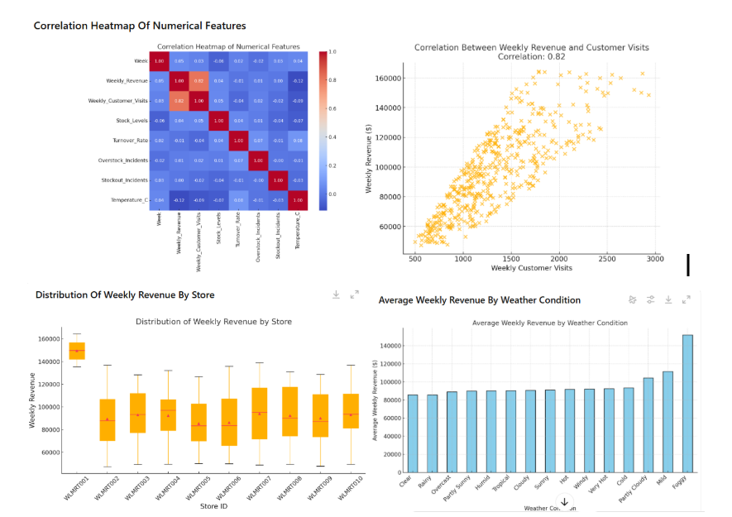
Practice Opportunity Solutions
© All rights reserved for Dr. Ryan Ahmed @Stemplicity Inc.

Slide 22
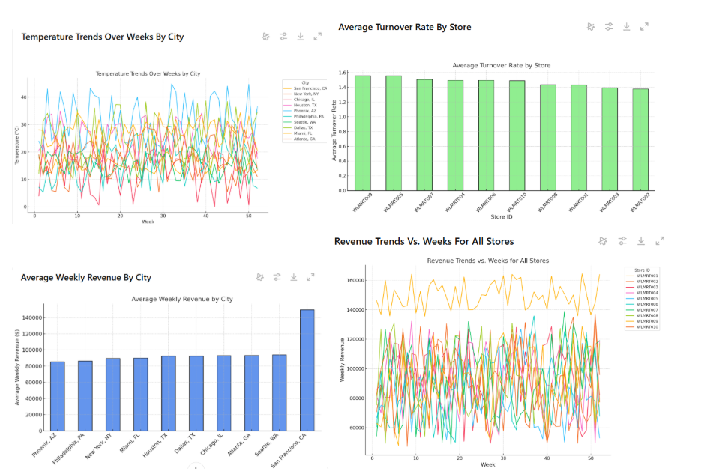
Practice Opportunity Solutions
© All rights reserved for Dr. Ryan Ahmed @Stemplicity Inc.

Slide 23
PRO TIP: SYNTHETIC DATA GENERATION USING CLAUDE

Slide 24
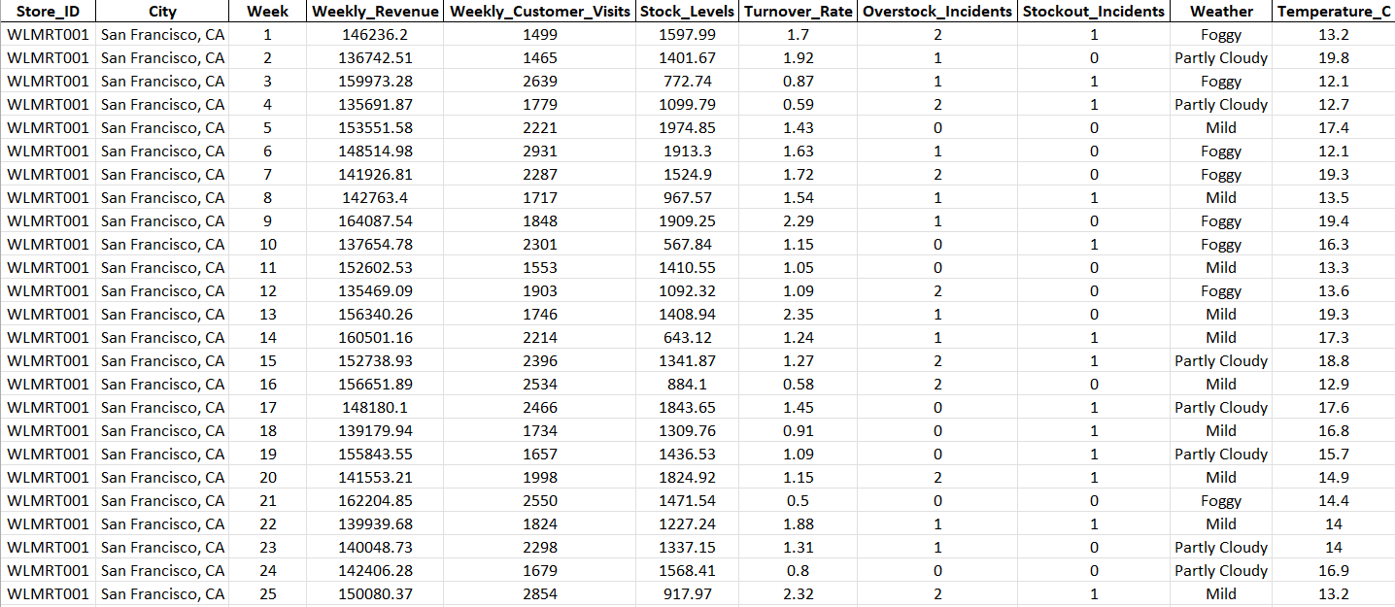
Synthetic Data Generation Using Claude
© All rights reserved for Dr. Ryan Ahmed @Stemplicity Inc.

Slide 25
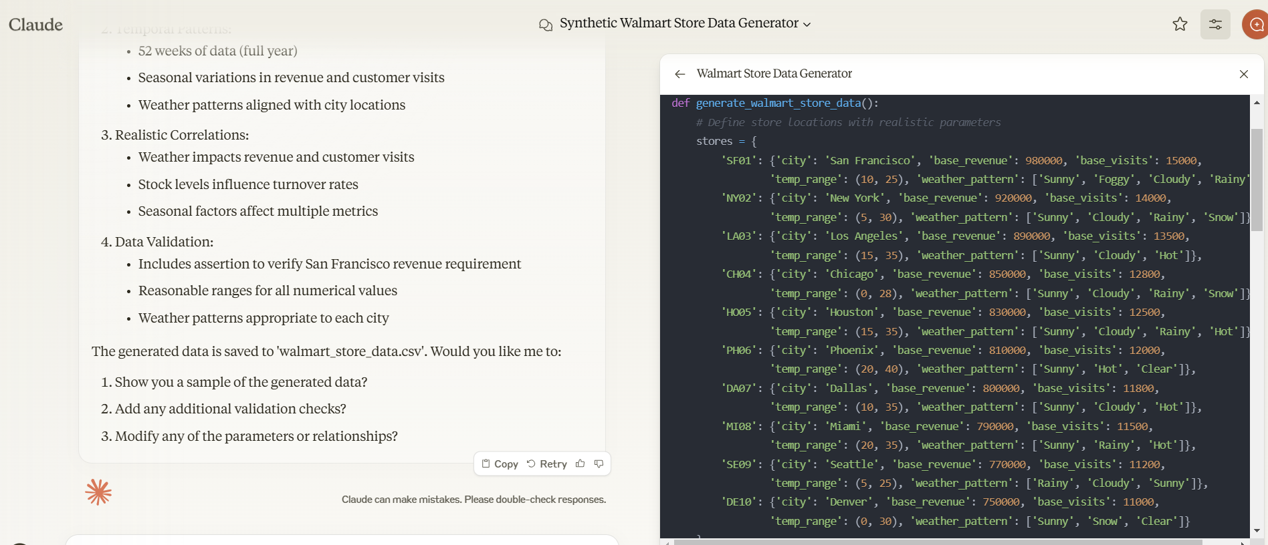
Synthetic Data Generation Using Claude
https://claude.ai/new
© All rights reserved for Dr. Ryan Ahmed @Stemplicity Inc.

Slide 26
Synthetic Data Generation Using Claude
Data Scope:
Generate synthetic data for Walmart stores.
Include data from 10 stores located in top US cities.
Ensure the weather data is consistent with the location and time.
Sanity Checks:
Verify that the generated data makes logical sense.
Ensure that the highest revenue is generated from the San Francisco store.
Fields to Include:
Store ID: Unique identifier for each store.
City: Location of the store.
Week: Week of observation.
Weekly Revenue: Revenue generated in USD.
Weekly Customer Visits: Number of customers visiting the store.
Stock Levels: Inventory levels.
Turnover Rate: Inventory turnover rate.
Overstock Incidents: Number of times the store was overstocked.
Stockout Incidents: Number of times the store ran out of stock.
Weather: Weather conditions during the week.
Temperature (°C): Weekly average temperature in Celsius.
© All rights reserved for Dr. Ryan Ahmed @Stemplicity Inc.

Slide 27
Thank you!

